Slide 1





Module 06 – Threads
WWW.SELACLOUD.COM

Slide 2

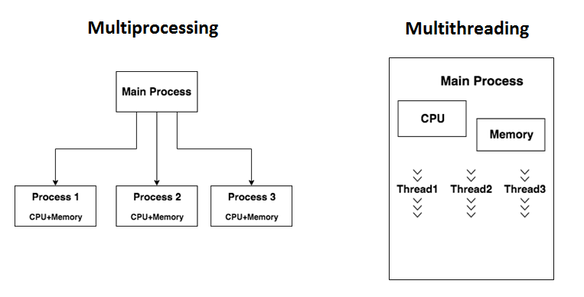
What is Thread
A Thread or a Thread of Execution is defined in computer science as the smallest unit that can be scheduled in an operating system
Threads are contained in processes. More than one thread can exist within the same process.
These threads share the memory and the state of the process.
Notes:
Python is dynamically-typed and garbage-collected. It supports multiple programming paradigms, including structured (particularly, procedural), object-oriented and functional programming.
It was built to be as readable as possible, and is significant indentation driven (Off-side rule).
The language's core philosophy is summarized in the document The Zen of Python (PEP 20), which includes aphorisms such as:
Beautiful is better than ugly.
Explicit is better than implicit.
Simple is better than complex.
Complex is better than complicated.
Readability counts.
For further reading:
Python (programming language) - Wikipedia

Slide 3
threading Module
Threading module is a simple way to create threads. Threading APls very similar to multiprocessing API
Using threads allows a program to run multiple operations concurrently in the same process space.
To create a new thread in out program we should use the Tread. class of Threading module
Notes:
Python is dynamically-typed and garbage-collected. It supports multiple programming paradigms, including structured (particularly, procedural), object-oriented and functional programming.
It was built to be as readable as possible, and is significant indentation driven (Off-side rule).
The language's core philosophy is summarized in the document The Zen of Python (PEP 20), which includes aphorisms such as:
Beautiful is better than ugly.
Explicit is better than implicit.
Simple is better than complex.
Complex is better than complicated.
Readability counts.
For further reading:
Python (programming language) - Wikipedia

Slide 4
Thread class
Thread(group=None, target=None, name=None, args=())
— target is the callable object to be invoked by the Process
— name is the process name
— args is the argument tuple for the target invocation.
— group — should be always be None
Thread has start and join functions, exactly like Process does

Slide 5
Threading Module example

Slide 6
Threading Module example
import time import threading global_num = 10 def func(): global global_num Global_num = 11 thread1 = threading.Thread(target=func) thread1.start() thread1.join() print(global_num)

Slide 7
Threading module Synchronization
threading module has 3 classes for threads synchronization, like multiprocessing module
Lock - non-recursive lock object
Rlock - recursive lock object
Semaphore — created with internal counter and can be acquired counter times before released
lock = threading.Lock()
with lock:
# critical section code
Notes:
PyCharm is currently one of the most used IDE for python development, It provides code analysis, a graphical debugger, an integrated unit tester, integration with version control systems (VCSes), and supports web development with Django as well as data science with Anaconda.
It was created by JetBrains
It is mostly popular because of many things, such as:
It is considered as an intelligent code editor, fast and safe refactoring, and smart code.
Features for debugging, profiling, remote development, testing the code, auto code completion, quick fixing, error detection and tools of the database.
Support for Popular web technologies, web frameworks, scientific libraries and version control.

Slide 8
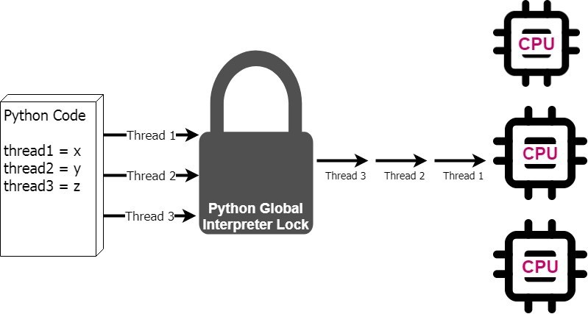
The Global Interpreter Lock
In CPython, the Global Interpreter Lock (GIL), is a mutex that protects access to Python objects, preventing multiple threads from executing Python bytecodes at once.
The GIL is controversial because it prevents multithreaded CPython programs from taking full advantage of multiprocessor systems
There are some GIL free operations, such as I/O and image processing. They happen outside the GIL.
The multithreaded programs that spend a lot of time inside the’ i GIL, interpreting CPython bytecode, that the GIL becomes a bottleneck
Notes:
PyCharm is currently one of the most used IDE for python development, It provides code analysis, a graphical debugger, an integrated unit tester, integration with version control systems (VCSes), and supports web development with Django as well as data science with Anaconda.
It was created by JetBrains
It is mostly popular because of many things, such as:
It is considered as an intelligent code editor, fast and safe refactoring, and smart code.
Features for debugging, profiling, remote development, testing the code, auto code completion, quick fixing, error detection and tools of the database.
Support for Popular web technologies, web frameworks, scientific libraries and version control.

Slide 9
Lab 01

